Slide 1
Cluster Computing Project
By Amitoz Deol and Michael Spreitzer

Slide 2
Goals of Our Project
The goal for us is to set up a cluster of Raspberry Pis that gives us more computing power than we would have just using a single Pi. This allows us to split up processes for a task among several Pis. The end goal is to use the increased computing power of the cluster to run a distributed database.

Slide 3
So what do you need for Cluster Computing? (Hardware)
Several Raspberry Pis (at least 2)
A switch (to connect several Pis to a router)
Ethernet Cables (1 for the switch and 1 for each pi)
And naturally you need to either have a monitor setup with a keyboard and mouse OR a computer to ssh into one Pi to work from

Slide 4
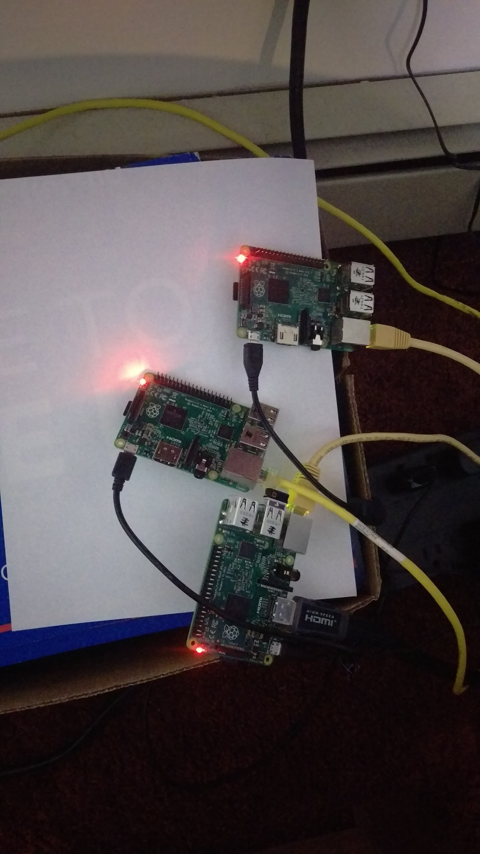
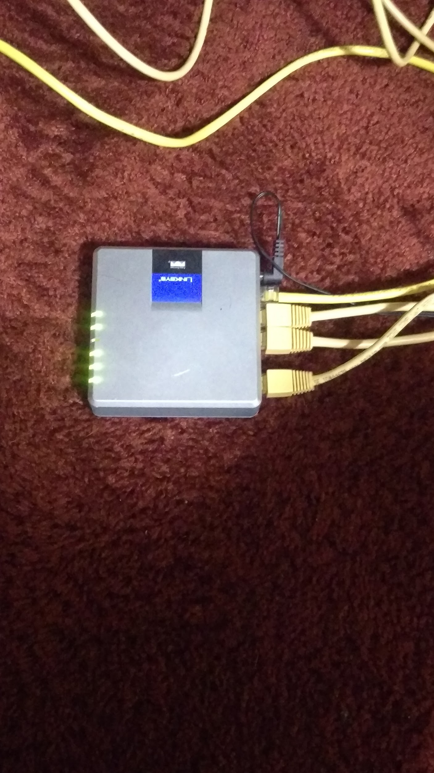
Here is Our Cluster and Switch Setup
On the left is the switch, set up and running and on the right is our three pi cluster (which we hope to eventually have a stand built for to keep it neater)

Slide 5
So what else do you need for Cluster Computing?
(Software)
Besides having an OS like Jessie installed on each Pi, the only software you need is MPI. Additionally, we used nmap to scan our Router’s network to ensure that all our Pis were connected to the network. We were not able to get Ansible working so we used MPI (Message Passing Interface) instead.

Slide 6
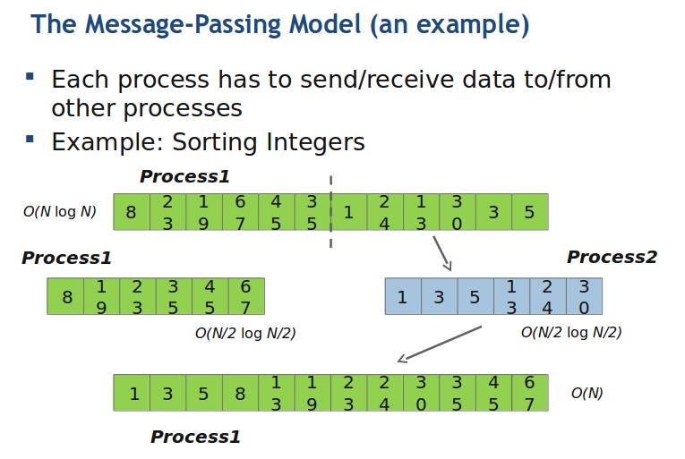
Working Of MPI

Slide 7
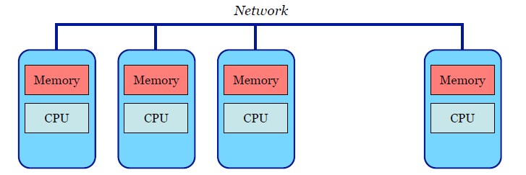
Distributed Memory Systems
• Each processor has its own private memory.
• A network connects all the processors.

Slide 8
Message-Passing Paradigm
• A parallel program is decomposed into processes, called ranks.
• Each rank holds a portion of the program’s data into its private memory.
• Communication among ranks is made explicit through messages.
• Channels honor first-in-first-out (FIFO) ordering.

Slide 9
Getting MPICH Set Up
First, we need to get and install MPI from http://www.mpich.org/static/downloads/3.1/mpich-3.1.tar.gz
Then, we need to add it as a path to our BASHRC boot file
But we also need a Python to MPI interpreter. We get that from https://mpi4py.googlecode.com/files/mpi4py-1.3.1.tar.gz
We need to get the IP addresses of all of our Pis and put them in a file called machinefile.
nano machinefile and type all the ip’s to seperate lines.
But we also needed to make our Pi’s IP addresses static

Slide 10
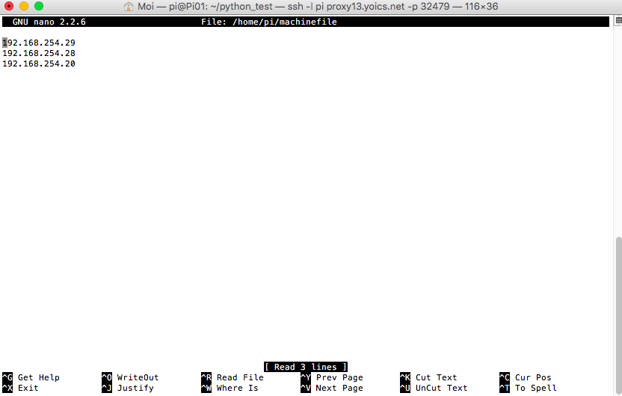
The Machinefile with our IP Addresses

Slide 11
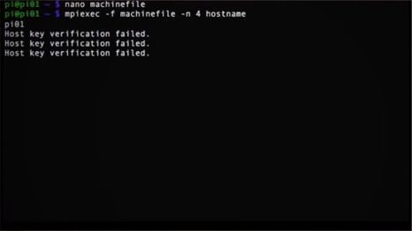
This is where stuff gets interesting
So now we have given static ip addresses to all our pi’s but if we run this command
“mpich -f machinefile -n 3 hostname”, we will get an error saying that host key
verification failed. To get rid this error, we had to make an “authorization_key”
file to store the keys generated by each pi on our master pi “Pi01”

Slide 12
Getting MPICH Set Up (Part 2)
Then, we ‘ssh’ into other pi’s and generate rsa keys specifically for each Pi.
We use ‘scp’ (secure copy) to copy those keys to our “Master pi” and we use ‘cat’ to read them from our “Master Pi”.
After our cluster is ready to use, We created a Python code that crack md5 string values that are stored in a database files and run it on our cluster.
We use mpiexec to run our program to run our python code on all three pi’s
mpiexec -f machinefile -n 3 python python_test/md5_attack.py

Slide 13
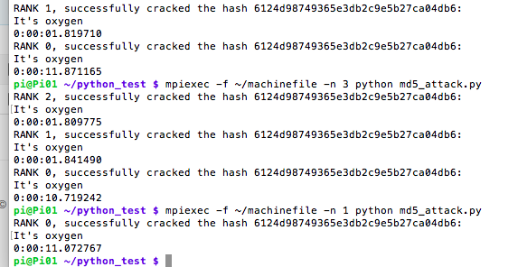
Successfully running the Python program
Here is the Python program being run successfully on all 3 Pis and then on only 1 Pi. Each Pi prints out “successfully cracked the hash…”, their Rank, and the time it takes to complete its share of the task.

